Slide 1
DIP Seminar Week3
최성욱

Slide 2
Contents
Connected-Component Labeling(CCL)
Basic Concepts
Algorithms
Experimental Results and Analysis

Slide 3
1. Basic Concepts

Slide 4
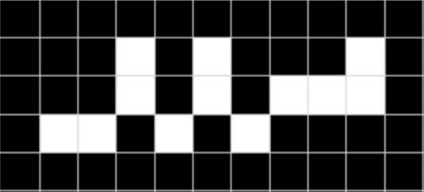
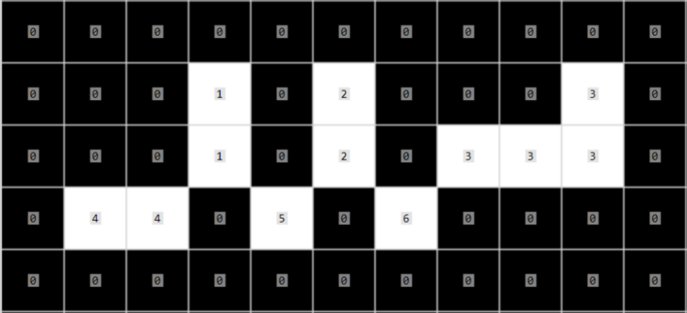
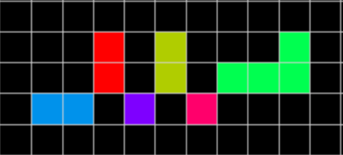
Connected-Components Labeling(CCL)
Connected components labeling(CCL) scans an image and groups its pixels into components based on pixel connectivity.
Once all groups have been determined, each pixel is labeled with a graylevel or a color (color labeling) according to the component it was assigned to.
CCL
color
(a)
(b)
(c)
(a) Original image
(b) Result of number labeling with 4-connectivity
(c) Result of color labeling with 4-connectivity

Slide 5
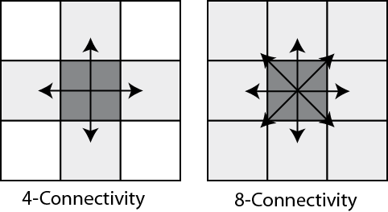
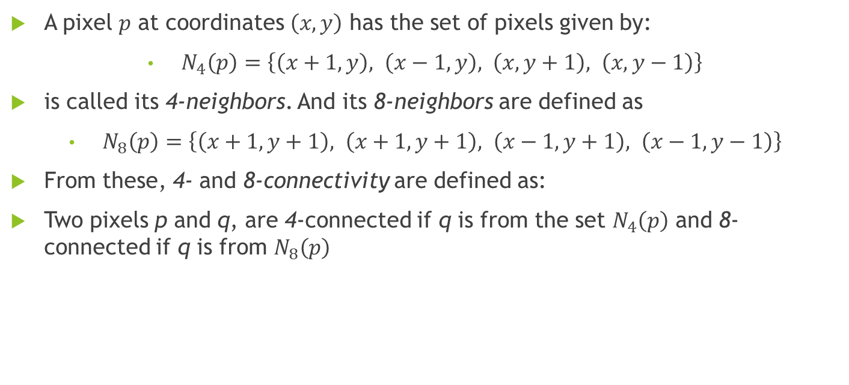
Pixel connectivity
A pixel $p$ at coordinates $\left(x,y\right)$ has the set of pixels given by:
$N_{4}\left(p\right)=\left\{\left(x+1,y\right), \left(x−1,y\right), \left(x,y+1\right), \left(x,y−1\right)\right\}$
is called its 4-neighbors. And its 8-neighbors are defined as
$N_{8}\left(p\right)=\left\{\left(x+1,y+1\right), \left(x+1,y+1\right), \left(x−1,y+1\right), \left(x−1,y−1\right)\right\}$
From these, 4- and 8-connectivity are defined as:
Two pixels p and q, are 4-connected if q is from the set $N_{4}\left(p\right)$ and 8-connected if q is from $N_{8}\left(p\right)$

Slide 6

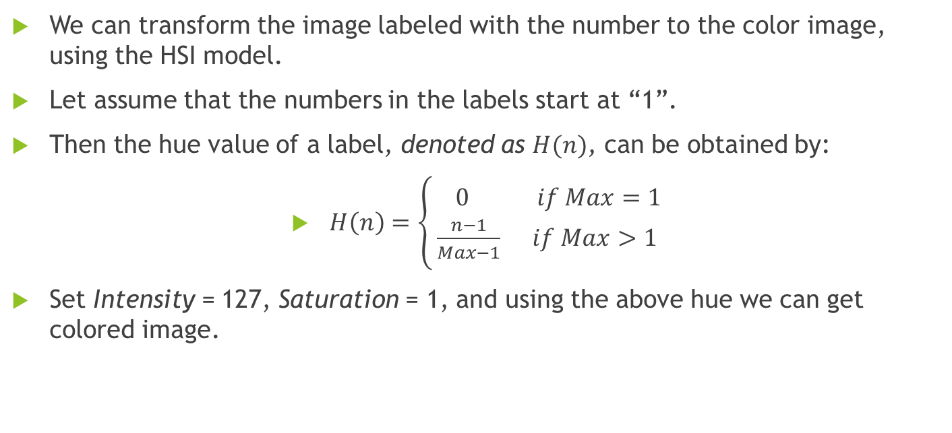
Color Labeling
We can transform the image labeled with the number to the color image, using the HSI model.
Let assume that the numbers in the labels start at “1”.
Then the hue value of a label, denoted as $H(n)$, can be obtained by:
$H\left(n\right)=\left\{\begin{aligned} 0 if Max=1 \\ \frac{n−1}{Max−1} if Max>1\end{aligned}\right.$
Set Intensity = 127, Saturation = 1, and using the above hue we can get colored image.
$n$ : a number in labels
$Max$ : the maximum number in labels

Slide 7
2. Algorithms

Slide 8
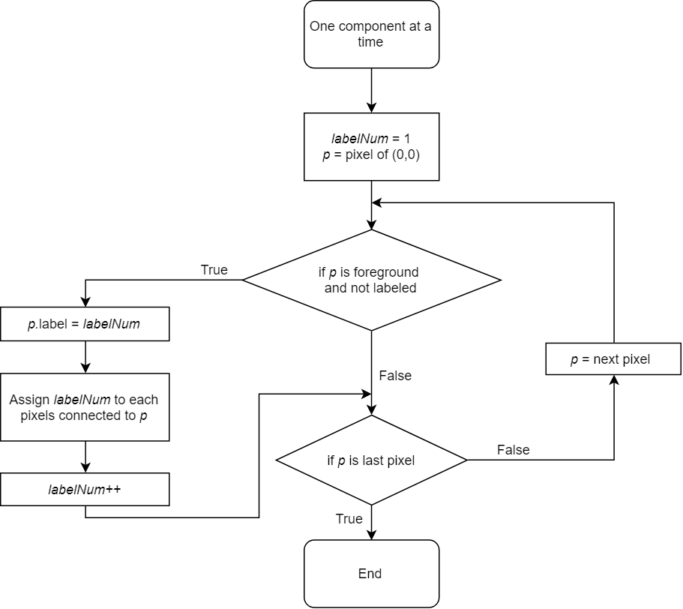
One component at a time
Once the first pixel of a connected component is found, all the connected pixels of that connected component are labelled before going onto the next pixel in the image.
(a)
(b)
(c)
Pixel-by-Pixel process
Component-by-Component process
Flow chart of algorithm

Slide 9
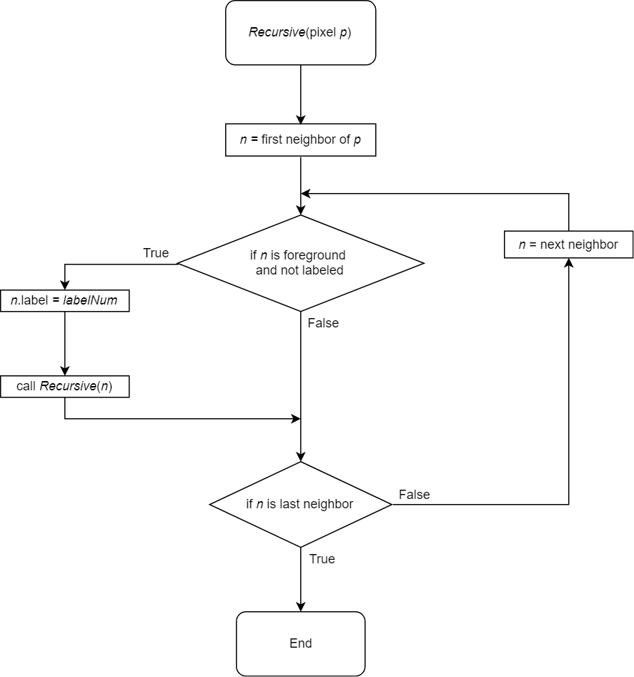
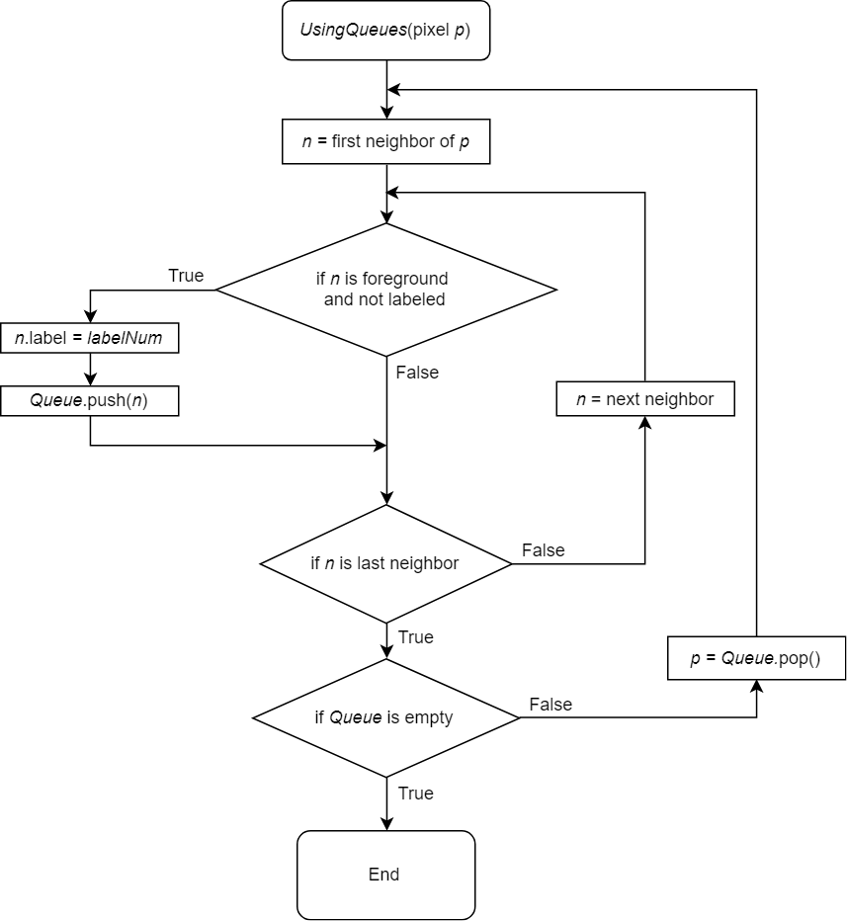
One component at a time -Methods to assign label to all the connected pixels
Using recursions
Using queues(or stacks)

Slide 10
One component at a time -Methods to assign label to all the connected pixels
(a) Using recursions
(b) Using queues
(c) Using stacks

Slide 11
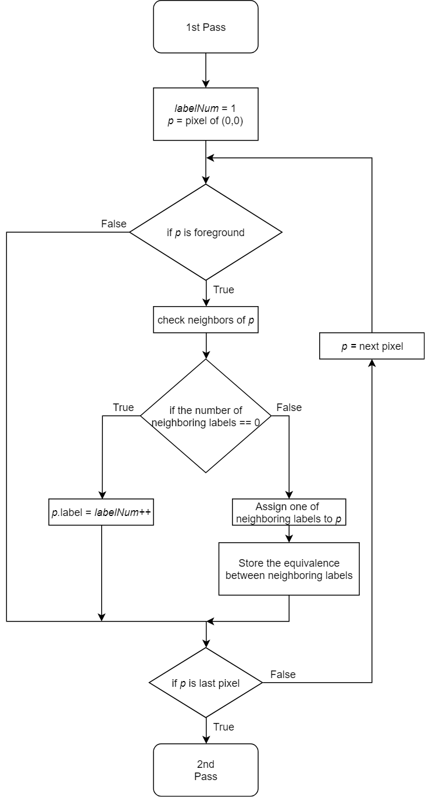
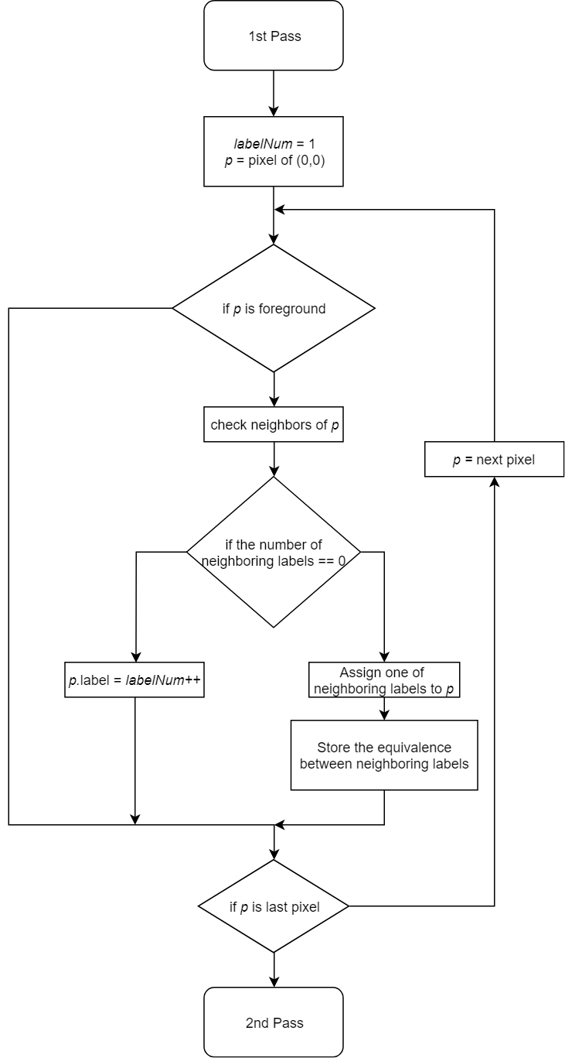
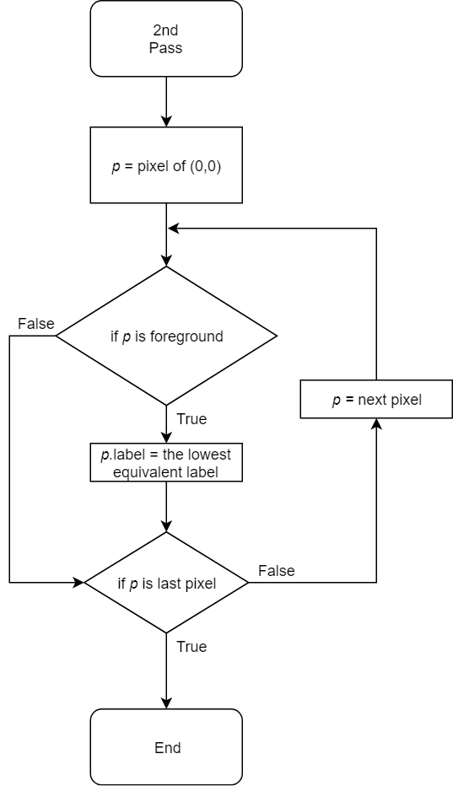
Two pass Algorithm
The algorithm makes two passes over the image.
The first pass is to assign temporary labels and record equivalences.
The second pass is to replace each temporary label by the smallest label of its equivalence class.

Slide 12
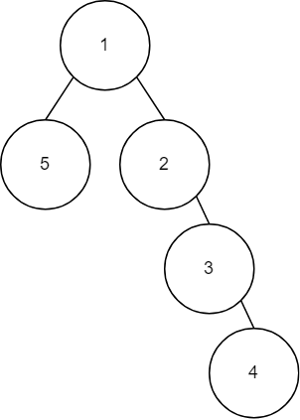
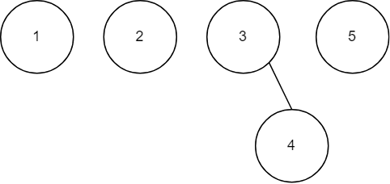
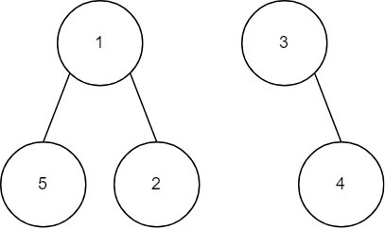

Union–Find data structure -Method to store the equivalences
Union(set x, set y)
{
set xRoot = Find(x);
set yRoot = Find(y);
if(xRoot.labelNum < yRoot.labelNum )
yRoot.parent = xRoot;
else
xRoot.parent = yRoot;
}
A union-find set forest consists of a number of elements each of which stores an id(label number), a parent pointer.
The union-find set has three main operations, MakeSet, Union, Find.
MakeSet(labelNum n)
{
set x;
x.labelNum = n;
x.parent = x;
add x to the sets;
}
set Find(x)
{
if (x.parent != x)
x.parent = Find(x.parent);
return x.parent;
}
Pseudo codes of MakeSet, Union, Find.
MakeSet(1:4)
Union(3,4) MakeSet(5)
Union(1,2), Union(1,5)
Union(2,3), Union(1,2)

Slide 13

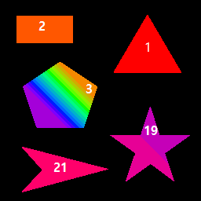
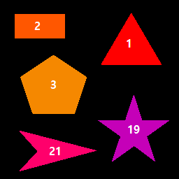
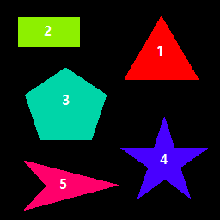
Two pass Algorithm
Label | Equivalent Labels
1 | 1
2 | 2
3 | 3 4 5 6 7 8 9 10 11 12 13 14 15 16 17 18
4 | 3 4 5 6 7 8 9 10 11 12 13 14 15 16 17 18
5 | 3 4 5 6 7 8 9 10 11 12 13 14 15 16 17 18
6 | 3 4 5 6 7 8 9 10 11 12 13 14 15 16 17 18
7 | 3 4 5 6 7 8 9 10 11 12 13 14 15 16 17 18
8 | 3 4 5 6 7 8 9 10 11 12 13 14 15 16 17 18
9 | 3 4 5 6 7 8 9 10 11 12 13 14 15 16 17 18
10 | 3 4 5 6 7 8 9 10 11 12 13 14 15 16 17 18
11 | 3 4 5 6 7 8 9 10 11 12 13 14 15 16 17 18
12 | 3 4 5 6 7 8 9 10 11 12 13 14 15 16 17 18
13 | 3 4 5 6 7 8 9 10 11 12 13 14 15 16 17 18
14 | 3 4 5 6 7 8 9 10 11 12 13 14 15 16 17 18
15 | 3 4 5 6 7 8 9 10 11 12 13 14 15 16 17 18
16 | 3 4 5 6 7 8 9 10 11 12 13 14 15 16 17 18
17 | 3 4 5 6 7 8 9 10 11 12 13 14 15 16 17 18
18 | 3 4 5 6 7 8 9 10 11 12 13 14 15 16 17 18
19 | 19 20
20 | 19 20
21 | 21
stored
data
1st pass
(a)
2nd pass
(b)
Rearrange
(e)
(a) Original image
(b) The result of first pass
(c) The result of second pass
(d) Rearranged image of (c)
(e) Equivalence relationships after first pass
*The numbers in (b)-(d) indicate the label numbers.
(c)
(d)

Slide 14
3. Experimental results and Analysis

Slide 15
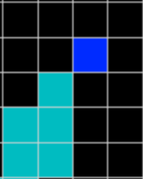
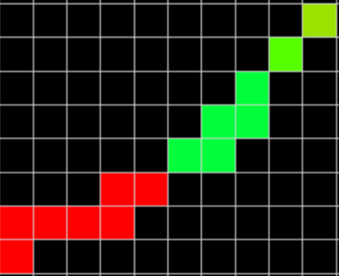
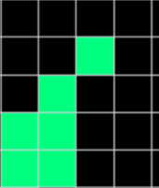
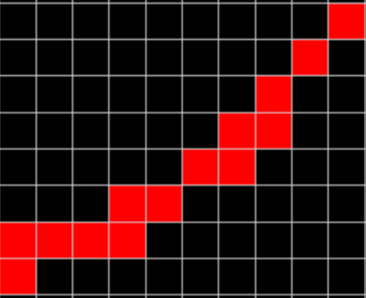
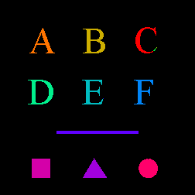
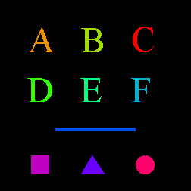
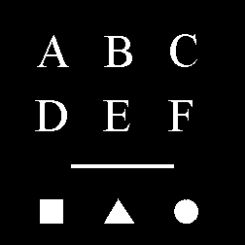
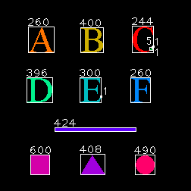
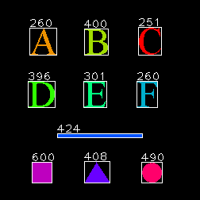
Experimental result -symbol.bmp
(b)
(c)
(a)
Original image
CCL with 4-connectivity
CCL with 8-connectivity
Annotated image of (b).
Annotated image of (c).
*The numbers indicate the counts of pixels in each component.
(d)
(e)

Slide 16
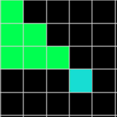
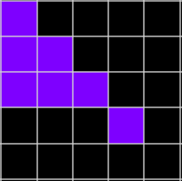
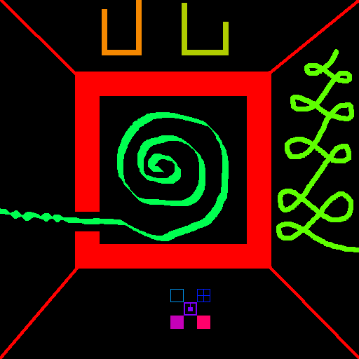
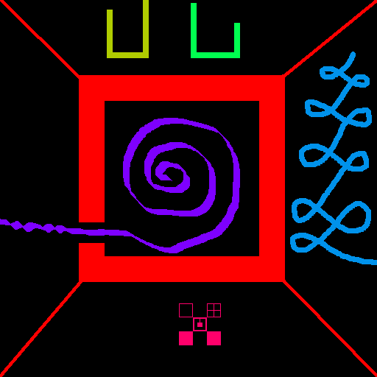
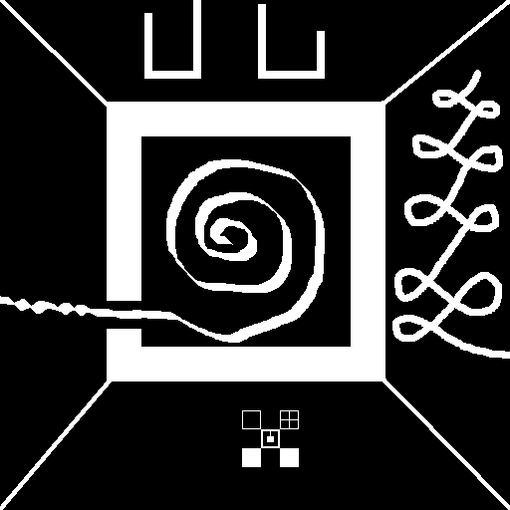
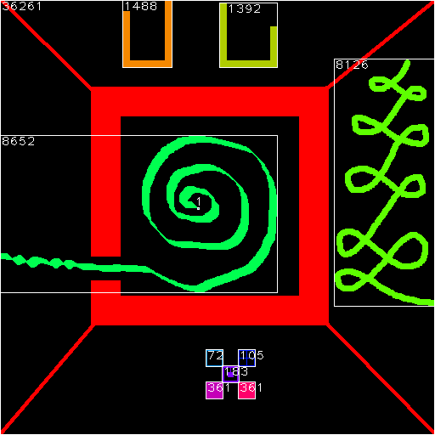
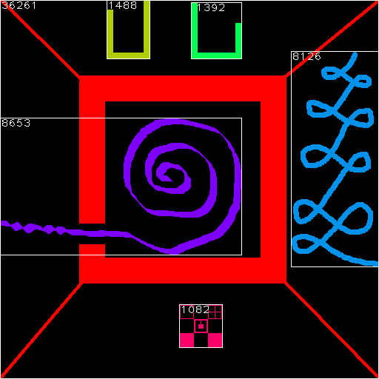
Experimental result -haze.bmp
(b)
(c)
(a)
Original image
CCL with 4-connectivity
CCL with 8-connectivity
Annotated image of (b).
Annotated image of (c).
*The numbers indicate the counts of pixels in each component.
(d)
(e)

Slide 17
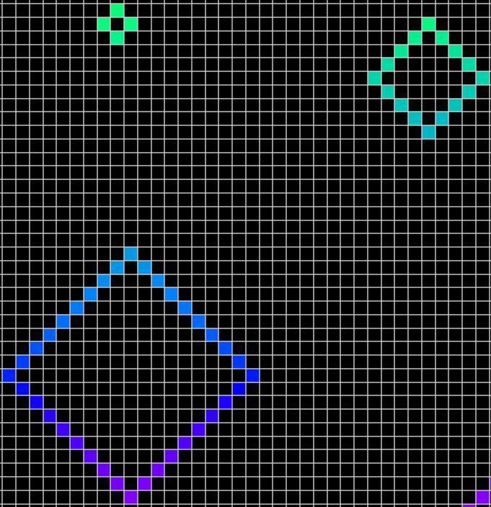
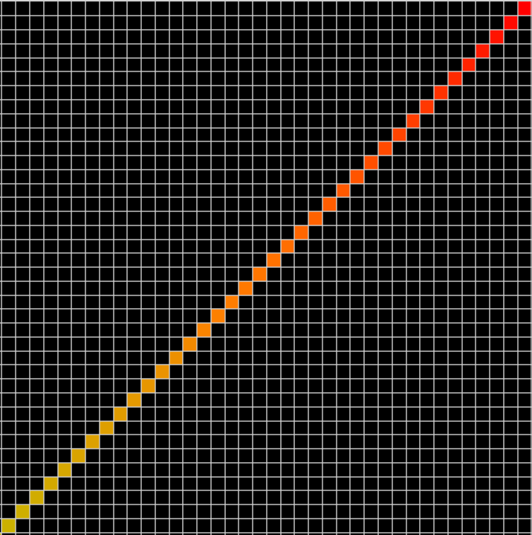
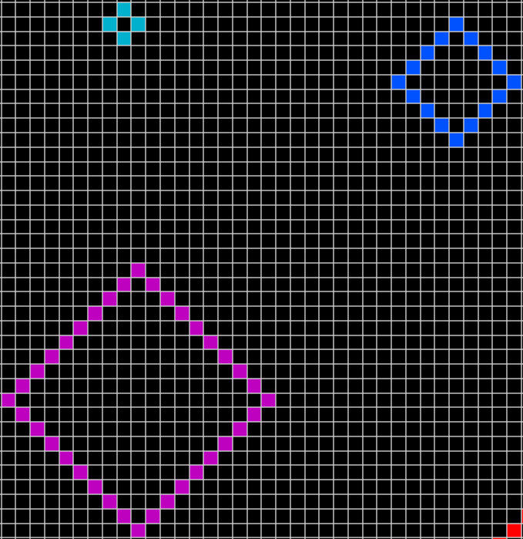
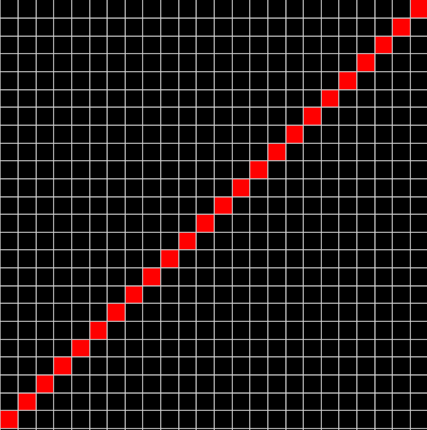
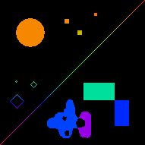
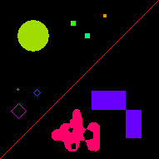
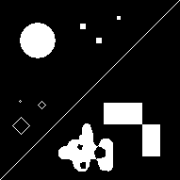
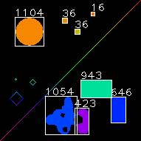
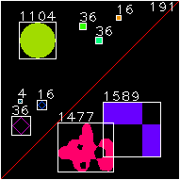
Experimental result -moonlight.bmp
(b)
(c)
Original image
CCL with 4-connectivity
CCL with 8-connectivity
Annotated image of (b).
Annotated image of (c).
*The numbers indicate the counts of pixels in each component.
(a)
(d)
(e)

Slide 18
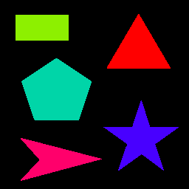

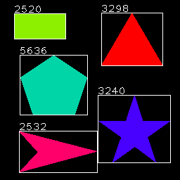
Experimental result -polygon.bmp
(b)
(c)
Original image
CCL with 4-connectivity
CCL with 8-connectivity
Annotated image of (b).
Annotated image of (c).
*The numbers indicate the counts of pixels in each component.
(a)
(d)
(e)

Slide 19
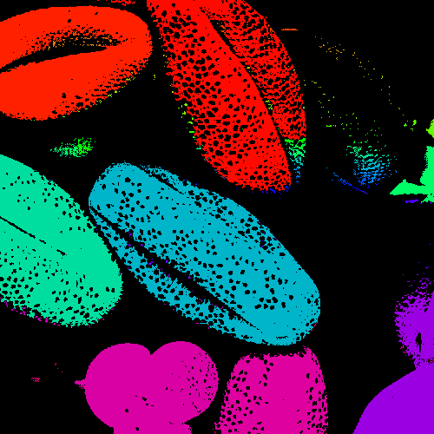

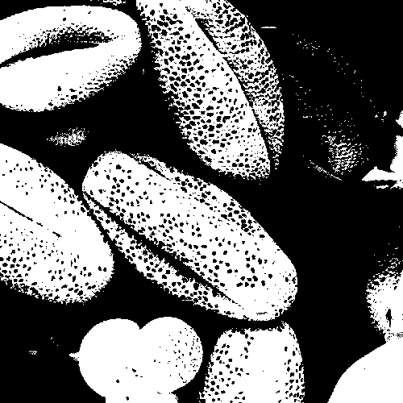
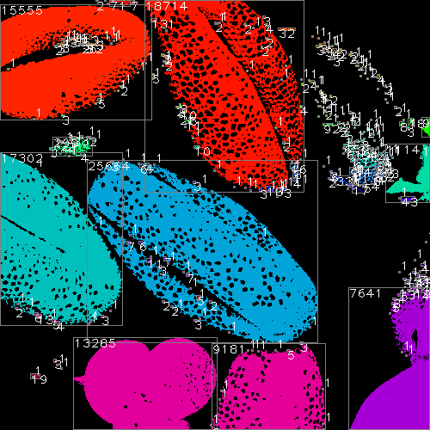
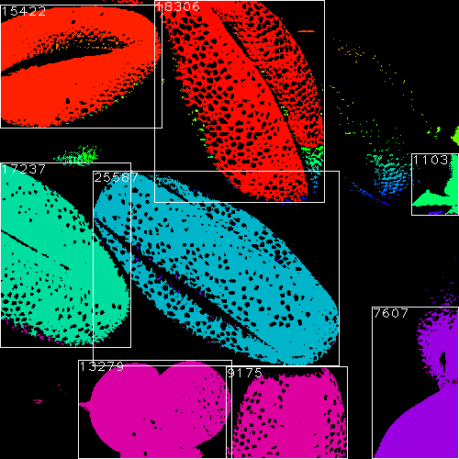
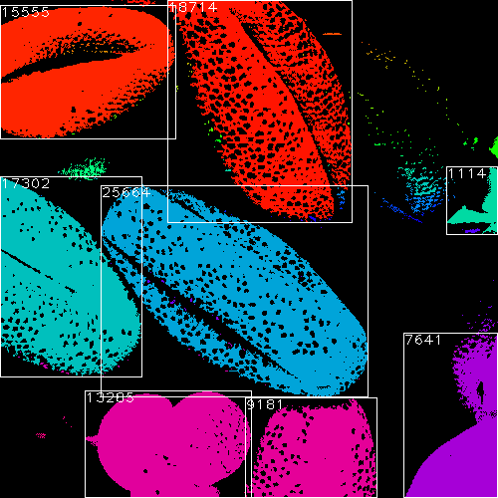

Experimental result -pollen.bmp
(b)
(c)
(a)
Original image
CCL with 4-connectivity
CCL with 8-connectivity
Annotated image of (b).
Annotated image of (c).
*The numbers indicate the counts of pixels in each component.
(d)
(e)
Annotations only if pixel count ≥ 1000

Slide 20







Experimental result -footprint.bmp
(a) Original image
(b) Result of CCL with 8-connectivity
(c) Annotated image of (b)
Annotations without text
Neighbor size increased to 5x5(24-connectivity)

Slide 21




neighbor size | components (count) | non-1pixel components (count)
3x3 | 1532 | 859
5x5 | 345 | 296
7x7 | 228 | 221
9x9 | 181 | 181
11x11 | 155 | 155
13x13 | 117 | 117
17x17 | 71 | 71
(a) Neighbor size : 3x3
(b) Neighbor size : 5x5
(c) Neighbor size : 7x7
1st row of table: Connected neighbor size. All elements in nxn mask is connected.
2nd column of table: Count of all components.
3rd column of table: Count of components that have more than 1 pixel.
(d) Neighbor size : 9x9
(e) Neighbor size : 13x13
(f) Neighbor size : 17x17

Slide 22
Conclusion
I checked the differences between 4-connectivity, 8-connectivity, and n-connectivity.
I also checked the number of objects in image, and the area of the object.
By experimenting with various cases, I found that CCL is useful in digital image analysis and labeling of connected components in an image is central to many automated image analysis applications.

Slide 23
Referneces
[1] L. G. Shapiro, “Connected component labeling and adjacency graph construction”, Machine Intelligence and Pattern Recognition, vol. 19, pp. 1–30, 1996.
[2] R. Fisher, S. Perkins, A. Walker and E. Wolfart. , “Hypermedia Image Processing Reference”. J. Wiley & Sons, Ltd, pp. 114, 1996
[3] Abubaker, A; Qahwaji, R; Ipson, S; Saleh, M ; “One Scan Connected Component Labeling Technique”, 2007. ICSPC 2007. IEEE International Conference. p. 1283.
[4] Shapiro, L.; Stockman, G. (2002). “Computer Vision(pdf)”, Prentice Hall. pp. 69–73.

